Slide 1

What is a Worldview?
Notes:
Ask them to define what a worldview is. Give a couple of minutes for them to define it.

Slide 2

Worldview Defined
A worldview is a “particular philosophy of life or conception of the world. It’s the way one perceives the reality they live in.”
Worldview → Perspective
Values → Priorities
Decisions → Practices
(a). Does everyone have a worldview?
(b). What are some questions that
a worldview might attempt to answer?
Notes:
Worldview (Atheism) – I create my own morality rather than God. I value self so I can survive and others to make the world a more habitable place. My priority is to enjoy this life as much as possible because I will die and cease to exist. Try to get the most out of each day. I may decide to help out others and be self-sacrificial, but only for the purpose of man, not for God. When I make these decisions, I put them into practice.

Slide 3
A Worldview asks the Question
What is reality? (God, universe, force)
What is the nature of existence? (designed, chaotic, material, spiritual, both)
What is a human? (complex machine, evolved ape, free being, image of God, social being).
What happens at death? (extinction, reincarnation, heaven or hell).
What is right and wrong? (human choice, what feels good, survival).
What is the purpose of existence? (survival, success, prepare for life to come).

Slide 4

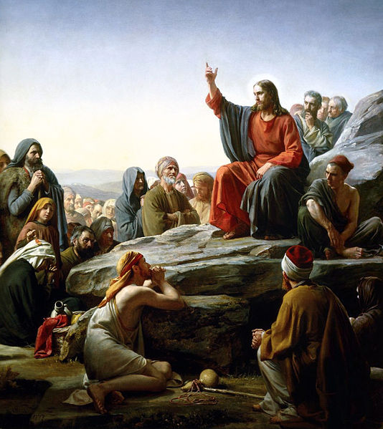
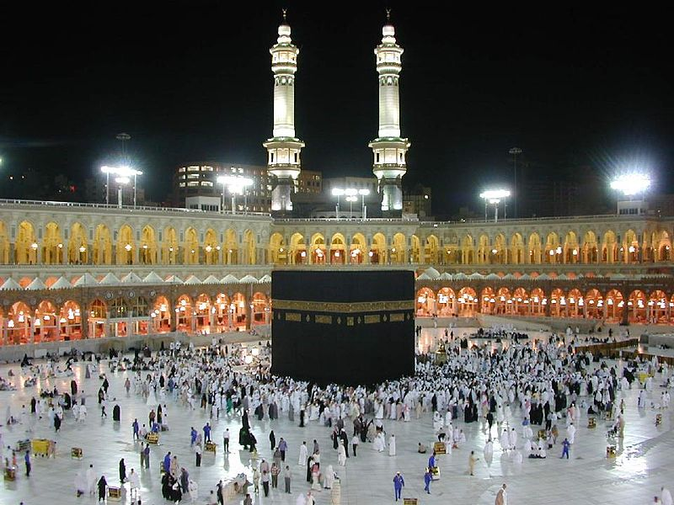
Worldview of Theism and Polytheism
Theism is defined as a belief in a God or gods.
Common monotheistic religions include Christianity, Islam, Judaism and polytheism include Zoroastrianism, Hinduism, Sikhism.
Notes:
Sermon on the mount. Jesus is the God of the universe. In the middle is the Kaaba in Mecca. Muslims from all aronud the world gather to pray in unity there. They believe it was built by Abraham and the first house that was built for humanity to worship Allah. Sikh to the right. Four open doors to the golden temple, which signifies that they are open to all religions. They do, however, believe in one God that is supreme over all.

Slide 5
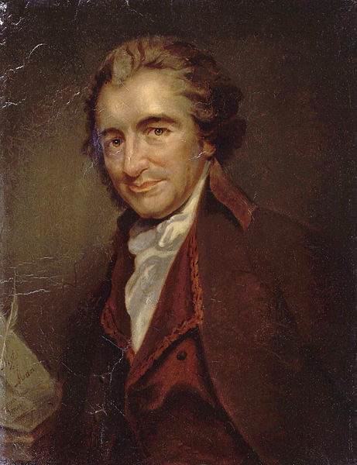
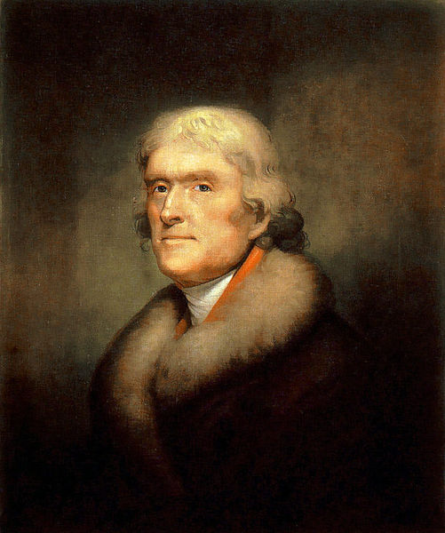

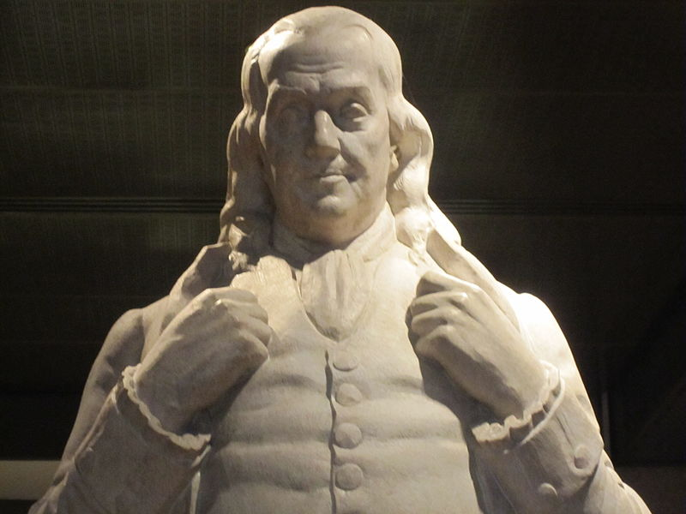
Worldview of Deism
Originated during the Age of Enlightenment 17th century. Why do you think Deism was popular during this time period?
Accepted existence of Creator on the basis of reason but rejected supernaturalism such as miracles, prayer, God’s intervention.
Notes:
Top right: Thomas Pain, wrote the book the Age of Reason, significant influence for Americanism and Deism in the United States. Bottom left hand corner is Benjamin Franklin. Was raised by Puritan parents, denied the deity of Jesus and Christianity as the only way, wrote his own beliefs about God but still realized this world was intelligently designed. Thomas Jefferson, a Deist, is known for the Jefferson Bible. He would cut out any scripture references that had miracles or healings.

Slide 6
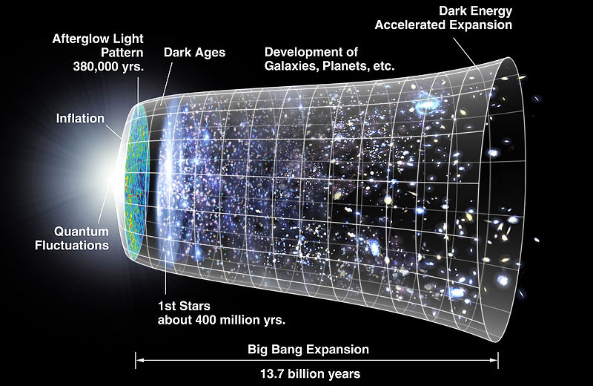
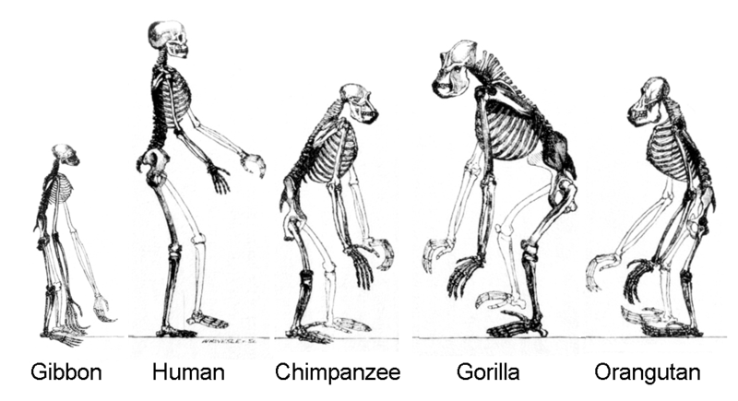
Worldview of Naturalism
The belief that only the natural (as opposed to supernatural) laws and forces operate in the world.
How does this worldview answer the question: What is the purpose of existence? What is mankind?

Slide 7

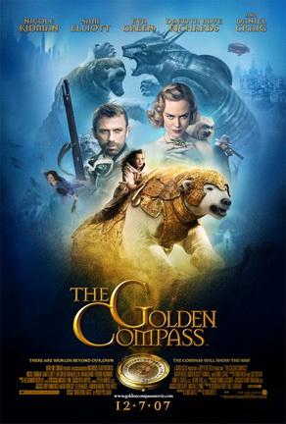
Naturalism in the Movies
Can you think of any other movies that have a naturalistic perspective on worldview?
Notes:
The Oberon's log reveals that the apes on board, led by Semos, organized a mutiny and took control of the vessel after it crashed. The human and ape survivors of the struggle left the ship and their descendants are the people Leo has encountered since landing. In the present, a battle ensues between the humans and the apes. A familiar vehicle descends from the sky and is identified immediately by Leo as the pod piloted by Pericles, the chimp astronaut. In 2029, aboard the United States Air Force space station Oberon, Leo Davidson (Mark Wahlberg) works closely with primates who are trained for space missions. His favorite simian co-worker is a chimpanzee named Pericles. With a deadly electromagnetic storm approaching the station, a small space pod piloted by Pericles is used to probe the storm. Pericles's pod heads into the storm and disappears. Against his commanding officer's orders, Leo takes a second pod and goes in pursuit of Pericles. Entering the storm, Leo loses contact with the Oberon and crashes on a planet called Ashlar in the year 5021. He discovers that the world is ruled by humanoid apes who can speak human language and treat human beings as slaves.
Leo comes across a female chimpanzee named Ari (Helena Bonham Carter), who protests the awful treatment humans receive. Ari decides to buy Leo and a female slave named Daena (Estella Warren) to have them work as servants in the house of her father, Senator Sandar (David Warner). Leo escapes his cage and frees other humans. Ari sees them, but Leo manages to convince Ari to join a human rebellion against the apes. General Thade (Tim Roth) and Colonel Attar (Michael Clarke Duncan) march ape warriors in pursuit of the humans. Leo discovers Calima (the temple of "Semos"), a forbidden, but holy, site for the apes.
Calima turns out to be the remains of the Oberon, Leo's space station, which has crashed on the planet's surface and looks ancient (the name Calima coming from the sign "CAution LIve aniMAls", the relevant letters being the only ones not covered in dust). According to the computer logs, the station has been there for thousands of years. Leo deduces that when he entered the vortex he was pushed forward in time, while the Oberon, searching after him, was not, crashing on the planet long before he did.
Pericles was pushed forward in time as Leo was, and had just now found his way to the planet. When Pericles lands, the apes interpret his landing as the return arrival of Semos, the first ape, who is their god. They bow, and hostilities between humans and apes disappear

Slide 8
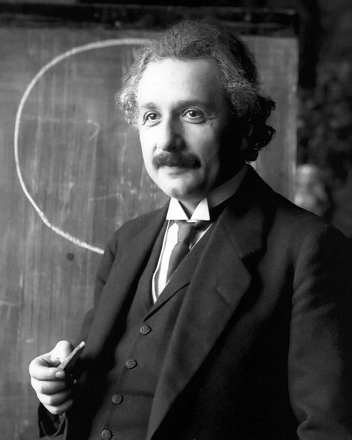
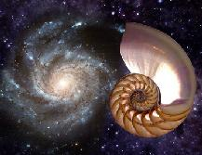
Worldview of Pantheism
Pantheism is the belief that the universe is identical with divinity. “All is god, and god is all.” The universe (with all its divine extensions, planets, suns, galaxies, thrones, and creatures) is what people and religions call “God.”
What 2 major religions have a pantheistic worldview?

Slide 9
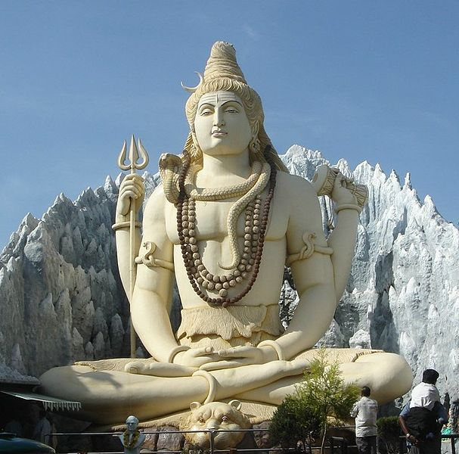
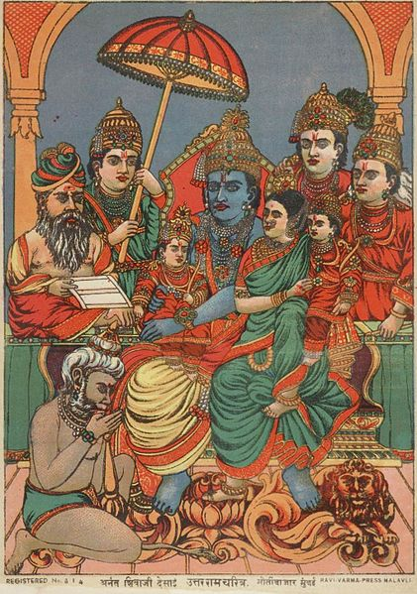
2 Major Religions of Pantheism
Hinduism teaches that the Atman (true self; human soul) is distinct from Brahman (the unknown reality of everything).
Notes:
The left is called the Rama family. It is the ideal self of everything: The ideal priest, the ideal god, the ideal wife, the ideal life, etc. The purpose is to find the ideal so you can interpret everything. To the right is the Shiva, which is famous for Yoga and Meditation. The goal is to attain permanent peace by emptying yourself of everything. How does this differentiate from Christian meditation?

Slide 10


2 Major Religions of Pantheism
Taoism believes that the ant, the grass, the clay tile, and even excrement is one. There is nowhere where the Tao is not.
How would this worldview explain the problem of evil?

Slide 11

Postmodernism
The belief that truth is fragmented. Truth is not the same for everyone. One religion tells one about God saving man; another tells one about man saving himself.
The cliché “What is true for you may not necessarily be true for me. Don’t impose your belief on me!”

Slide 12


Postmodernism
Skeptical interpretations of culture, literature, art, philosophy, history, etc.
There is no absolute moral truths. People create their own meaning and significance. How have you witnessed postmodernity in your life?

